Slide 1

IBM Data Science Capstone Project
By Nicolas Dinh

Slide 2



Introduction
This project concludes of the IBM Data Science Certification Specialization. This goal of this last module is about to apply the knowledge and skills acquired during the course to a real-life problem. This project will be about solving a hypothetical business problem with real data (geolocation data from Foursquare using RESTful API calls as well as data scrapped directly from the web using libraries like BeautifulSoup) and analyzing it using Python in a Jupyter Notebook.
Similar to the approach that was taken during the course with New York and Toronto, the focus of this project will be about finding an optimal neighborhood (suburb) in the city of Melbourne in order to open a French restaurant.

Slide 3

Business Problem
Melbourne is a city with a very multicultural population without over 200 nationalities and over 230 languages spoken. The city is the nest of a large amounts of communities and hosts numerous cultural events from music, international festivals to shows, expositions and galleries. And one of the big results of this multicultural aspect is the diversity of restaurants and food that the city has to offer.
My client, a French chef and entrepreneur asked me to take a data-driven approach to find a good place to open a French restaurant. Ideally, it would close to the city center and in a popular suburb outside of the CBD that already offer a large choice of restaurants, bars and cultural events/gathering.

Slide 4

Data gathering
In order to solve the above business problem, the following data would be required:
A list of the suburbs in Melbourne close to the CBD: this data can be scrapped from Wikipedia (https://en.wikipedia.org/wiki/List_of_Melbourne_suburbs).
The Geo-coordinates (latitude, longitude) associated to the Melbourne suburbs that can be obtained using the Geocoder library.
The popular venues data of each suburb from Foursquare using RESTful API calls.

Slide 5
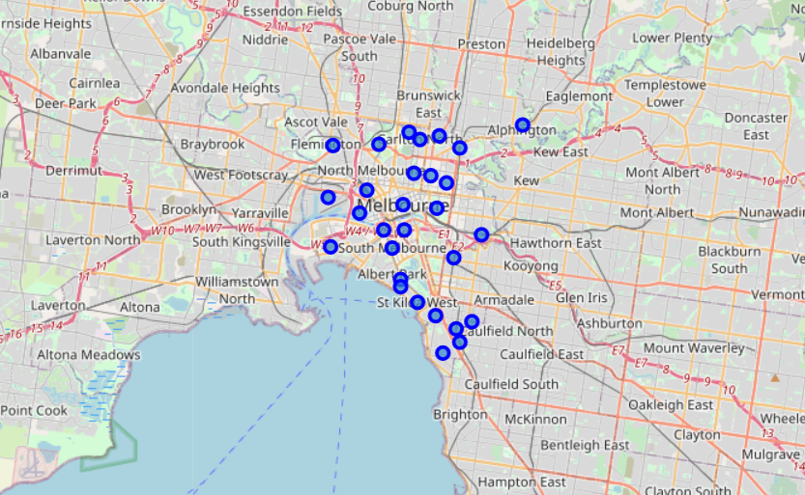
Visualization of the suburbs on a map

Slide 6

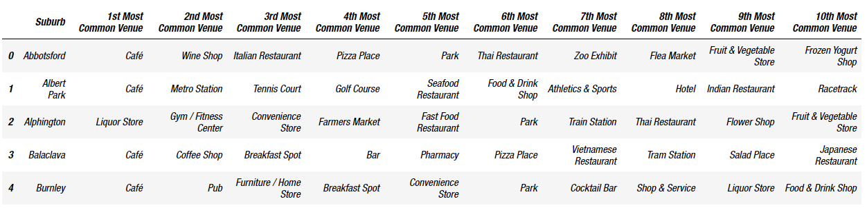
Most frequent venue category in each suburbs based on the Foursquare data
After exporting the list of most popular venues, we’re looking at the frequency of occurrence of each category of venues as per below:

Slide 7
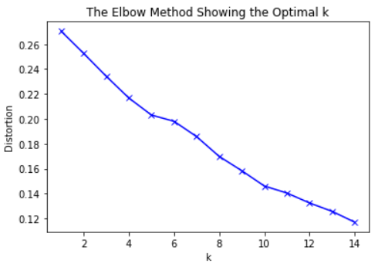
K-means clustering – choosing the optimal k
5

Slide 8

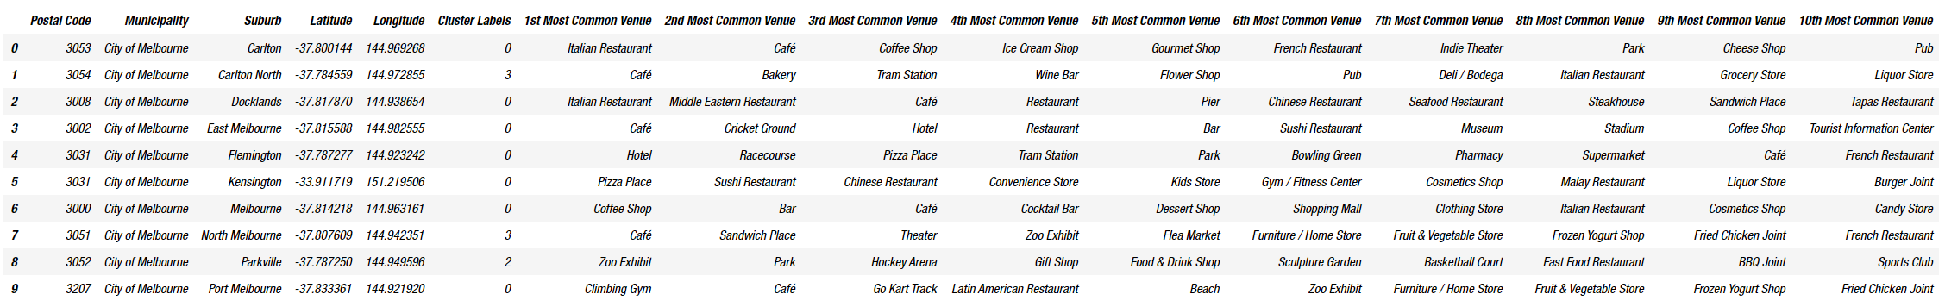
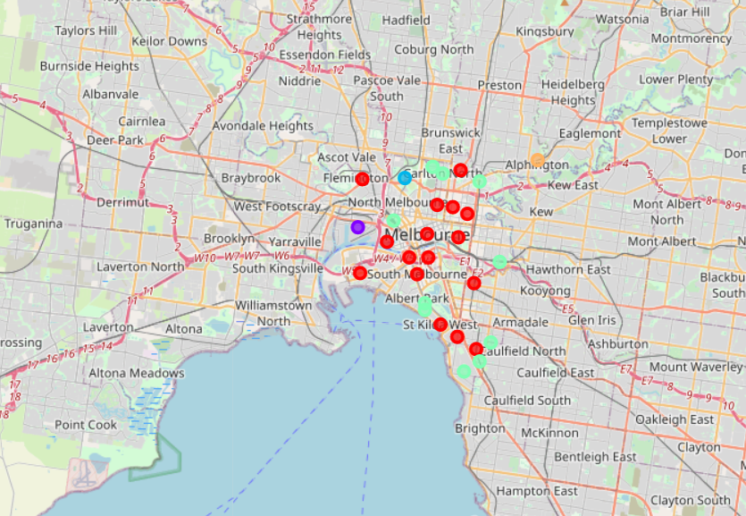
Model prediction and visualisation

Slide 9

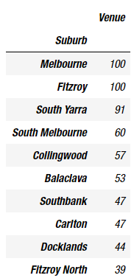
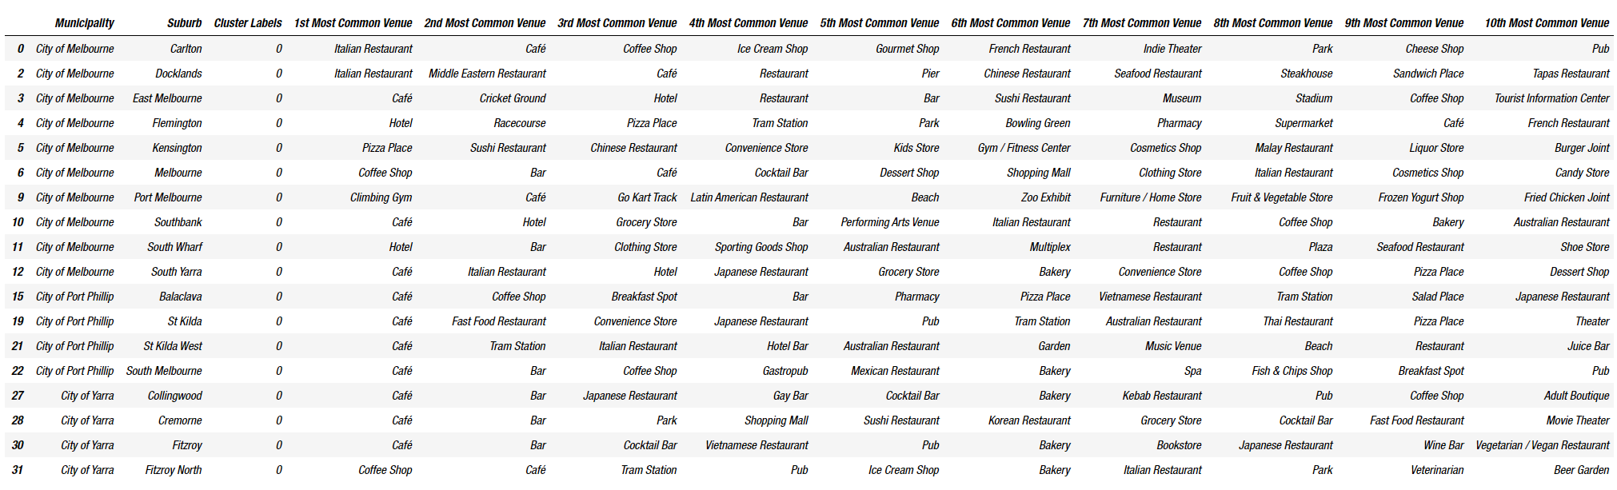
Recommendation
Most popular suburbs
Cluster 1 – Gastronomical center
Based on the above cluster, we can definitely recommend the 1st and 4th cluster to open a restaurant. However, based on a previous analysis we could see that Melbourne, Fitzroy and South Yarra are the suburbs with the highest density of restaurants, cafes and bars in a 500m radius. These 3 suburbs all belong to the 1st cluster. As the client wants to avoid opening a restaurant directly in the CBD but still wants proximity to it, the best suburbs to open a French restaurant would be Fitzroy or South Yarra.

Slide 10

Conclusion
Thank you for reading through all my project
In this project, we used different concepts and python libraries to come up with an answer to a real-life like business problem and use data from renown sources like Wikipedia and Foursquare. We’ve been able to use data science concepts that we learn along the specialization and apply it for this capstone project:
Data collection (using web-scraping techniques and RESTful API calls)
Data cleaning and preprocessing using pandas
Geo-coordinates data Visualization using Folium
Unsupervised machine learning to perform clustering using scikit-learn
All of these contributed to provide a recommendation to the business problem.

